Slide 1
Elisabeth Mitter, Scientific Coordinator, Office of Research, VPFW AVETH Event: Funding opportunities for Postdocs – Monday, 15 April 2019
Funding opportunities for Postdocs: ETHZ and SNSF

Slide 2
Overview
ETHZ internal funding
ETHZ Career Seed Grants
ETH Fellowships
Branco Weiss Fellowships
SNSF funding
Ambizione Fellowships
PRIMA Fellowships
Eccellenza Fellowships
Early Postdoc.Mobility
Postdoc.Mobility
Scientific exchanges and Agora
Some tips

Slide 3
ETH Zurich Career Seed Grants www.seedprojects.ethz.ch
Deadlines: 1 March and 1 September, decision within 4 months
Characteristics:
Funding for small, autonomous projects
Provide support to young researchers at ETHZ in establishing their own record of independent research
Explore or develop novel, ambitious ideas, new research directions and/or collaborations
E.g. pilot or feasibility studies, small, self-contained research projects, development of new methodology or technology
Beneficiaries:
High-performing early-stage postdocs with academic, non-permanent position at the ETH Zurich for the intended duration of the project
prior research output at ETHZ
Funding: 30’000 CHF for up to one year, covers research costs, user fees, targeted travel; no ongoing research or postdoc salaries
Evaluation Committee: ETH Research Commission
Country/Place: ETH Zurich

Slide 4
ETH Fellows www.ethfellows.ethz.ch
Deadlines: 1 March and 1 September, decision within 4 months
Characteristics:
Attract excellent young scientists at the beginning of their careers to the ETH Zurich
Own research idea; own initiative; first step towards independence
Conditions
Up to two years after PhD
Candidates must not have obtained their doctorate from ETH or UZH; must not have worked at ETH for more than 6 months
Proposal is submitted together with an ETH host professor, topic of proposal can be in all fields of the ETH
Two-step evaluation procedure
Duration and Funding:
24 months, salary and research costs, currently CHF 231’200 max
Country/Place: ETH Zurich
Evaluation Committee: ETH Research Commission
About 28 new fellows/year
Cofunded by Marie Sklodowska Curie-Actions

Slide 5
Society in Science – The Branco Weiss Fellowship http://www.society-in-science.org
Deadline: 15 January
Characteristics:
Supporting postdocs from all disciplines, with a novel and rigorous project, and willing to engage in dialogue with other disciplines and on relevant social issues
Fellows are free to work at research institutions anywhere in the world
Evaluated by Branco Weiss Directorate, selected ETH faculty members, and external reviewers
Two-step procedure with interview
Conditions:
up to five years after PhD
Record of outstanding scientific achievement
project departs from mainstream of discipline
Duration and Funding: Financial support (CHF 100’000 / year) for up to five years (2+3 years)
Target size: max.10 fellows p.a.
Success rate 1–3% overall, BUT…

Slide 6


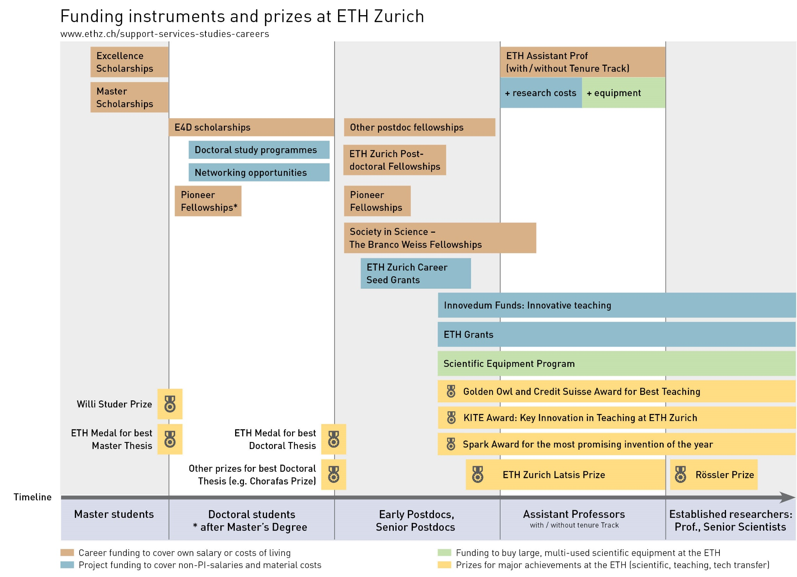
SNSF Career Funding Instruments
Mobility in SNSF projects
Doc.Mobility
Early Post-doc.Mobility
Postdoc. Mobility
PRIMA
Ambizione
Eccellenza Grants
Doctoral students
Postdocs
Assistant Professors

Slide 7
Ambizione Fellowships http://www.snf.ch/en/funding/careers/ambizione
Deadline at SNSF: 1 November 2019
Academic age:
at the latest 4 years after doctorate with at least 1 year of research experience as a postdoc
Duration:
max. 4 years, min 2 years of funding
Eligible Costs:
Salary: ~105 kCHF/Year (optional)
Project funds: max. 400’000 CHF for 4 years, e.g. doctoral student can be employed
Aimed at young researchers who wish to conduct, manage and lead an independent research project at a Swiss institution
for outstanding researchers aiming at an academic career; step towards early scientific independence
Research stay at other institution (CH, abroad or non-academic) can be included
Open to all researchers: from Switzerland and abroad
Mobility requirement: at least 12 months of research at institution other than doctorate institution

Slide 8
PRIMA – Promoting Women in Academia http://www.snf.ch/en/funding/careers/prima
Deadline at SNSF: 1 November 2019
5-year fellowships for excellent female researchers
Aim: promote scientific independence of highly qualified women researchers with excellent research idea
Increase chances of obtaining a professorship
Non-linear career paths welcome
No prior mobility required, but have to plan research stay at another host institution during PRIMA fellowship
New: leadership programme: coaching, workshops, networking
Transfer of PRIMA grants: if appointed a professorship in Switzerland during PRIMA, remaining funds can be transferred to the new position.
Eligibility: 2–10 years after doctorate, with at least two years of postdoctoral research activity
Contribution: in total: ~ CHF 1.2 mio. salary + project funds: max. CHF 750’000 for 5 years

Slide 9
Obligations of the universities (PRIMA & Ambizione): confirmation letters
Internal deadline: 15 October 2019 SNSF deadline: 1 November 2019
Consists of two separate documents:
Detailed confirmation of the host unit: Submission to the Office of Research by 15 October 2019 in electronic format; signature of Contact Person and Head of Department mandatory
General confirmation by the VPFW Following receipt, a letter signed by VPFW will be issued and sent to the Contact Person before the SNSF submission deadline
Attention: Time of employment in non-permanent working contracts at the ETH Zurich is limited – check before applying

Slide 10
Limited time of employment in non-permanent working contracts
Mobility is important – a research career at ETH Zurich is not possible, a research career without mobility is almost impossible.
Time of employment in non-permanent working contracts at the ETH Zurich is limited:
Six years as scientific assistant (Doctoral Student and/or Postdoc)
Six years as senior assistant (Oberassistent/Oberassistentin)
Twelve years maximum in total in all ETH domain institutions together
Age limit for new assistant professor positions at ETHZ: ~35 years

Slide 11
SNSF-Eccellenza (replaced the SNF-Professorships)
SNSF deadline: 1 February 2020
SNSF Eccellenza Professorial Fellowships
Objective: obtaining a permanent professorship
Eligible are outstanding researchers from all disciplines that have not yet obtained an AP
Eligibility: at least 3 and max. 8 years after PhD; CH citizen or have worked at CH institution for at least 2 years
Award: own salary, plus project funds of up to CHF 1 Mio, for 5 years; no extension.
SNSF Eccellenza Grants
Eligible: Researchers in all disciplines who have recently been appointed as AP with tenure track
Eligibility Window: min. a granted position at the start of the project and max. 18 months of employment as APTT at the time of submission
Award: project funds for 5 years, max. CHF 1.5 Mio.
More information: ETHZ Office of Faculty Affairs

Slide 12
SNSF: Early Postdoc.Mobility Fellowships (EPM)
Deadlines: 1 March and 1 Sep, to be discontinued by the end of 2020
Goal: research stay abroad after PhD, to enhance academic profile, preparation for scientific career (in Switzerland)
Research location: different form place of education, not in the home country
Eligibility: Candidates have obtained or will soon obtain their doctorate from ETH (application between 9 months before and 2 years after PhD completion possible) & must have a valid residence permit to apply
Benefits: grant for subsistence costs at research location, for 18 months (+ 6 months by host institution, if possible), funding level adapted to host country, higher rates for grantees accompanied by spouses and children, plus travel allowance, research costs, budget for conference attendances
Evaluation committee: ETH Zurich Research Commission
Success rate: currently around 50 %.

Slide 13
SNSF: Postdoc.Mobility Deadlines: 1 February, 1 August
Goal: research stay abroad after PhD, to enhance academic profile, preparation for scientific career (in Switzerland)
Research location: different from place of education, not in the home country
Eligibility: up to three years after PhD completion and valid residence permit
Benefits: same as EPM
Duration: stay abroad for 24 months (12 months min), with possible return grants to CH from 3 to 12 months,
…for previous EPM-Fellows, a PM as a prolongation is possible. However, time windows become very narrow!
Evaluation committee: SNSF committee
Success rate: about 50%
Elisabeth Mitter
16

Slide 14
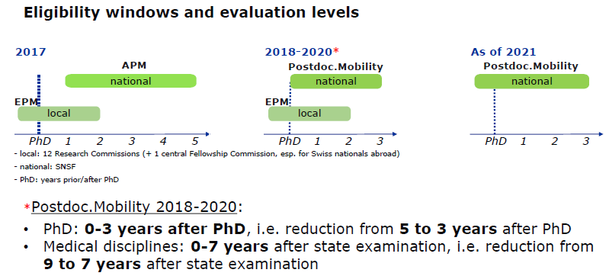
SNSF: Postdoc.Mobility: Towards one postdoc mobility scheme
Next Deadline:
1 August 2019
Next Deadline:
1 September 2019
Condition: Valid residence permit or CH passport on submission date
EPM = Early Postdoc.Mobility: Supported stay abroad by SNSF: 18 months. ETH Zurich Research Commission expects + 6 months paid by host in lab abroad.
PM = Postdoc Mobility: Supported stay abroad by SNSF 24 months, with possible return grants to CH from 3 to 12 months, open to all researchers, evaluated by SNSF directly
Elisabeth Mitter
5

Slide 15
SNSF: Scientific Exchanges and Agora
Scientific Exchanges:
to set up and strengthen international networks
to host scientific events (eg conferences) or conduct research visits (applicant visits researchers abroad or hosts guests), 6 months max
between CHF 2’500 and CHF 25’000
Agora:
public science communication projects
related to own research
to foster dialogue between science and society
between CHF 5k and CHF 200K for 3 years max
Elisabeth Mitter
16

Slide 16
Some tips
Science first!
Urban legends - be aware that they exist and find out for yourself
Read carefully through the instructions: deadlines, check your eligibility, if in doubt contact the managing offices
Plan ahead – eligibility windows might close
Start early – you also need reference letters, confirmation of host institutions, etc.
Talk to people who have won a fellowship (e.g. p3 research database)
Get informed about the evaluation committee
SNSF instruments:
Information events at/by SNSF: Advanced researchers’ days, Research days at universities
Ask SNSF staff – they know best
Elisabeth Mitter

Slide 17
Thank you for your attention!
Further information:
Office of Research
ethfellows@sl.ethz.ch
snf_fellows@sl.ethz.ch
Elisabeth Mitter
elisabeth.mitter@sl.ethz.ch

